Slide 1


IBM Case Study
Operations Management
Final Presentation
Group 1:
Nehal Mishra (nm3637)
Parva Shah (pss9192)
Achal Shah (ads925)
Felipe Montoya (fm2324)

Slide 2
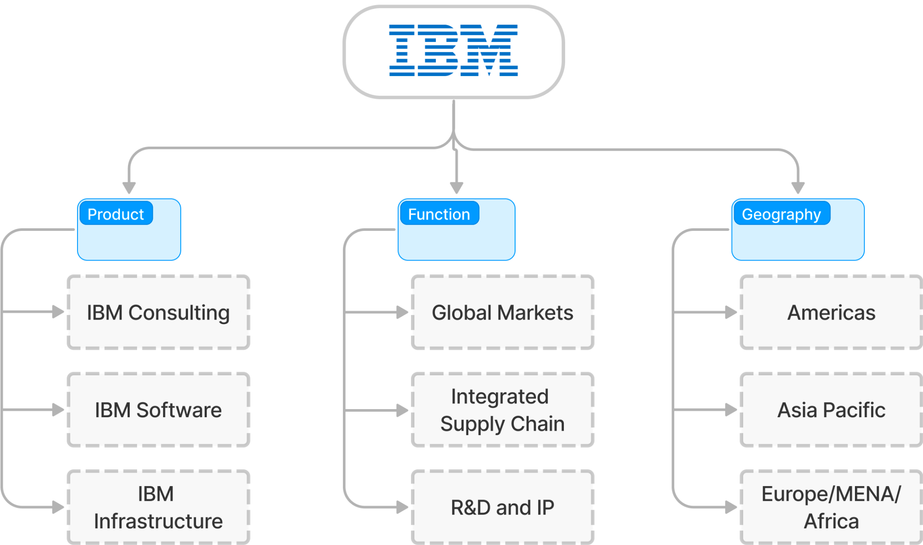
Introduction
IBM established in 1911 in Endicott, NY
Multinational corporation leader in hardware, software, infrastructure & consultancy services in B2C/B2B
Still, one of the biggest employers in the world, with > 200,000 employees
Generated $57.4 billion in revenue and $12.8 billion in cash from operations
Source: Gennaro Cuofano, 2022.

Slide 3
2. Problem
Due to this it is facing challenges in HR and Consultancy Services along with Cloud products. It is essential to analyze this problem w.r.t the following:
Services and process strategy
LEAN Management and Agile
HR Management
Supply Chain and Sustainability
Although IBM is a leading global company in hardware and software services the management at IBM opts to have a decentralized structure across its many international branches & departments

Slide 4
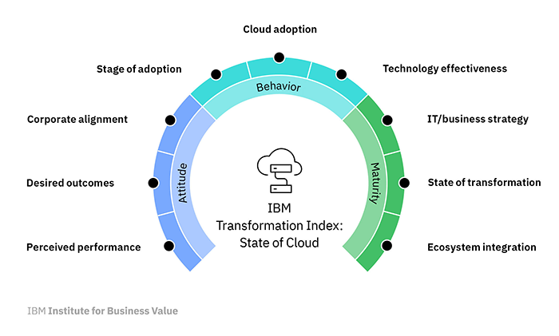
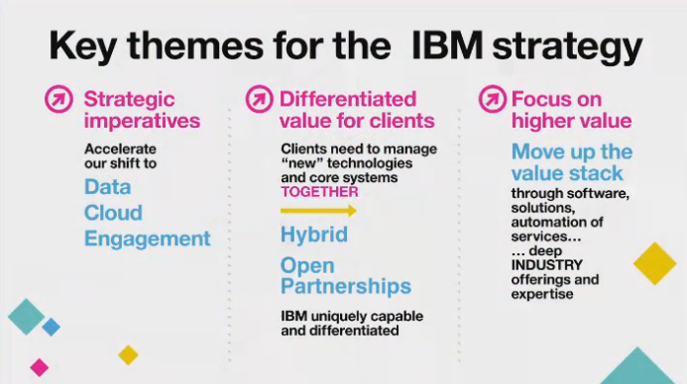
3. Service & Process Strategy: Analysis
IBM platforms & products are focused on providing solutions for different processes & industry.
IBM has changed its business over the last century, one feature has remained constant: its innovation-focused business approach. AI and the cloud are prevalent in today's digital world. IBM's corporate plan to dominate in the hybrid cloud and AI.
Solutions:
Accelerating Digital Transformation - Includes of managing
heterogeneous Information Technology Environment, data insights,
competitive operations, addressing cyber crime
Differentiated Architecture for Business Innovation - Modernize the
hybrid cloud, automate end to end pipelines and bridge clients with
sustainability
Source: IBM - Institute for Business Value
Source: IBM Servers (Twitter)

Slide 5
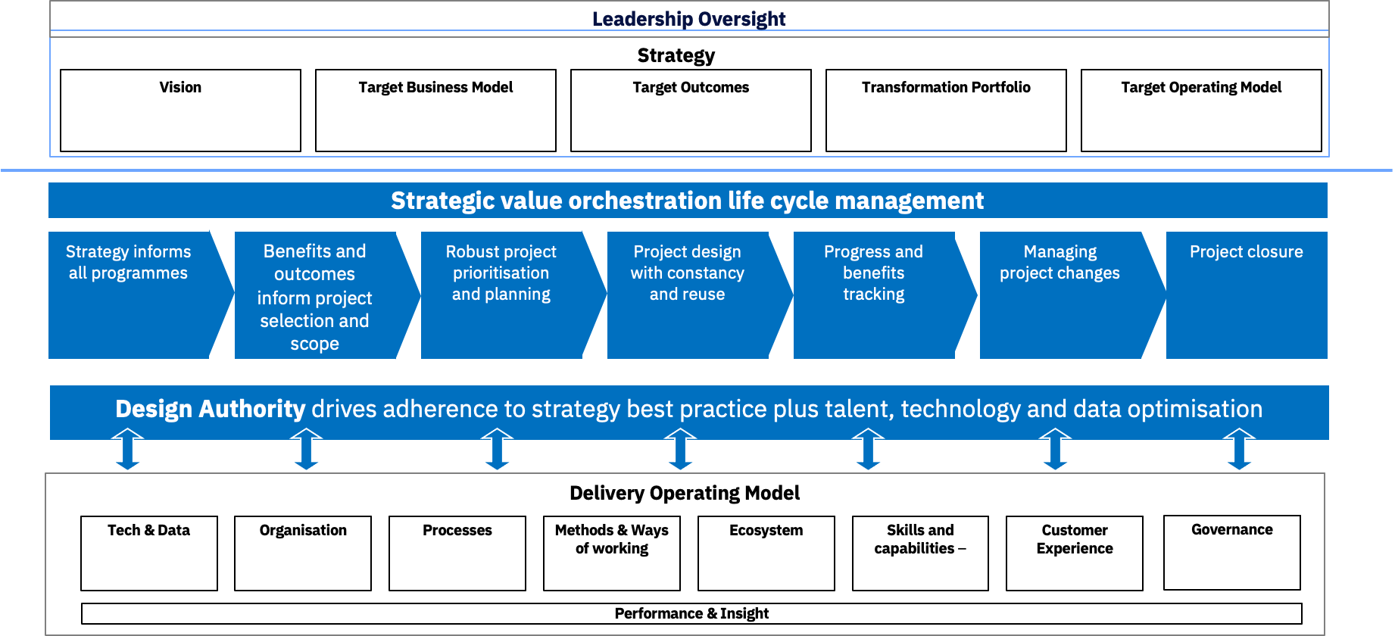
3.1Service & Process Strategy: Job Shop and Mass Customization
Higher variety, complexity, skill level and scheduling complexity but lower volume and fixed costs. IBM’s Job Shop is able to handle any kind of volume and costs:
Process-focused, product-focused and make to stock type of Job shop.
At micro-level there are many sub-services in these domains
Challenges of this model:
Application Dependency
Cloud First Initiatives
Data Center Expenses
Hardware Refresh
Skillset Dependency
Source: IBM UK & Ireland

Slide 6
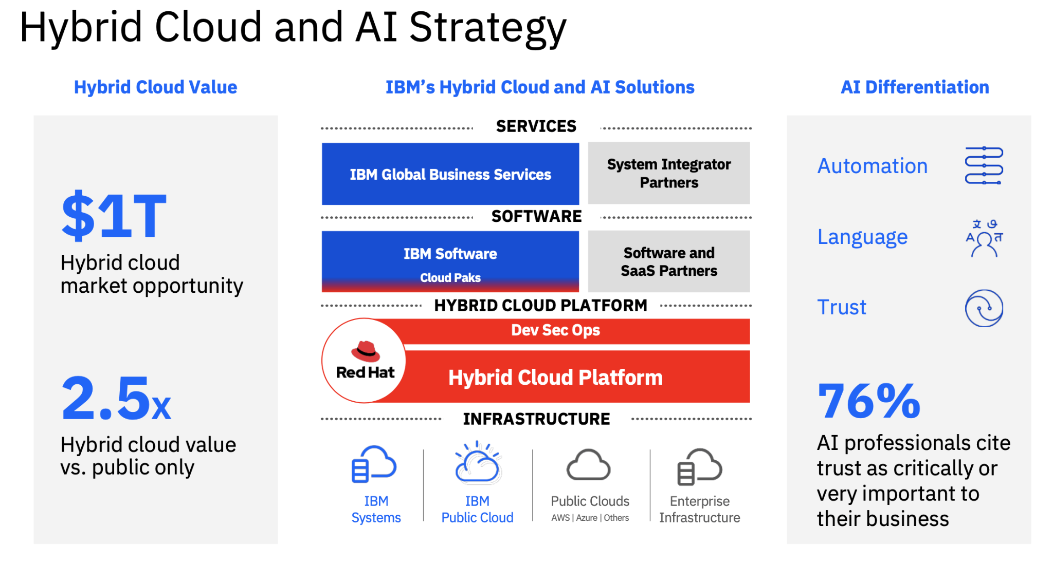
3.2 Service & Process Strategy: Solutions & Recommendations
IBM Data Centers in Dallas, Melbourne and Seattle closed down (upgrading & modernization costly)
Cloud approach instead of Data centers:
Partners want to understand more of business impact and methodology of Transformation
On top of that they need more system administrators who understand this work
IBM is innovative company and has pivoted successfully many times in past, a lot services are not doing well. (3% decline IBM Infrastructure in 2022, according to Annual Report)
Strategy should be between Job Shop and Mass Customization. This way it can concentrate on being flexible and differentiated at the same time
Source: IBM Cloud - Seeking Alpha

Slide 7

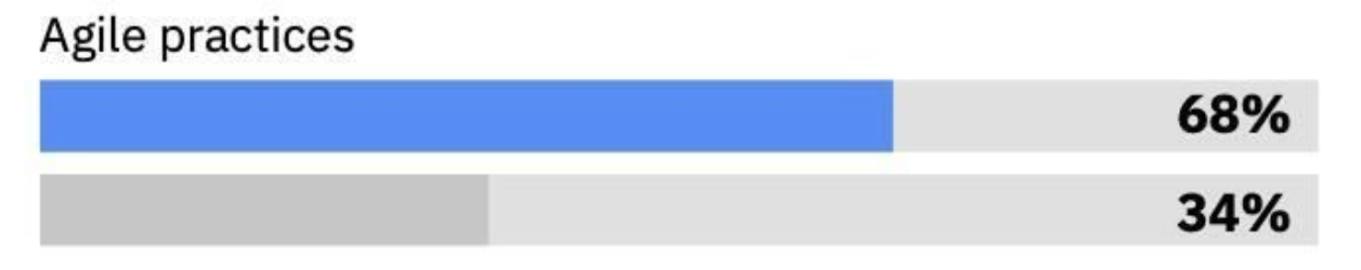
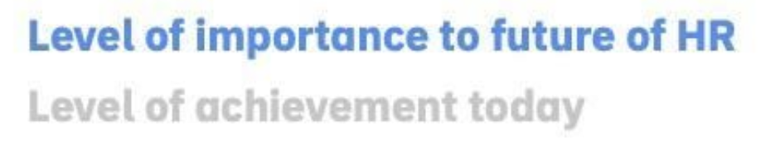
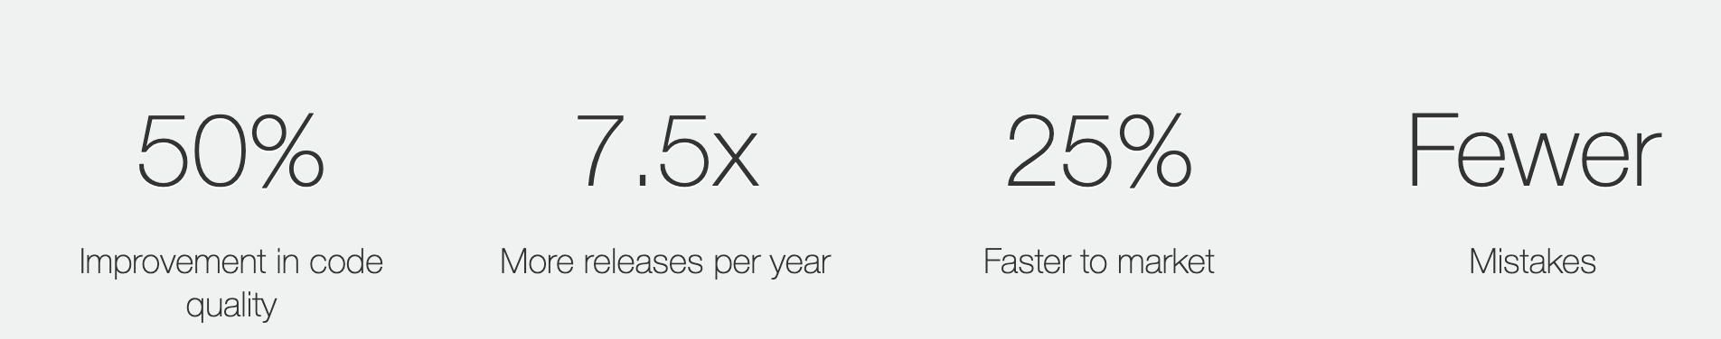
4. LEAN Management & Agile: Analysis
IBM® Global Technology Services® / Agile for Services (AFS):
Continuous Service Improvement (DevOps Backbone). (Kaizen)
Fit-for-use framework not one-size-fits-all (Poka-yoke).
AI & Data-driven to allow client co-creation (Prioritization of technology)
Empower Employees: Lean Engineers
IBM® Global Business Services® / Simpler®:
LEAN + Six Sigma
Issues:
70% Velocity Improvement responses for customer services.
According to report, only 34% of IBM’s process apply Agile
Simpler® Consulting acts completely independent to the Agile Team
No ambassadors of different Agile Teams across several countries in IBM
Source: IBM - Josh Bersin Academy - HR Management
Source: https://www.ibm.com/ibm/devops/us/en/agile/

Slide 8
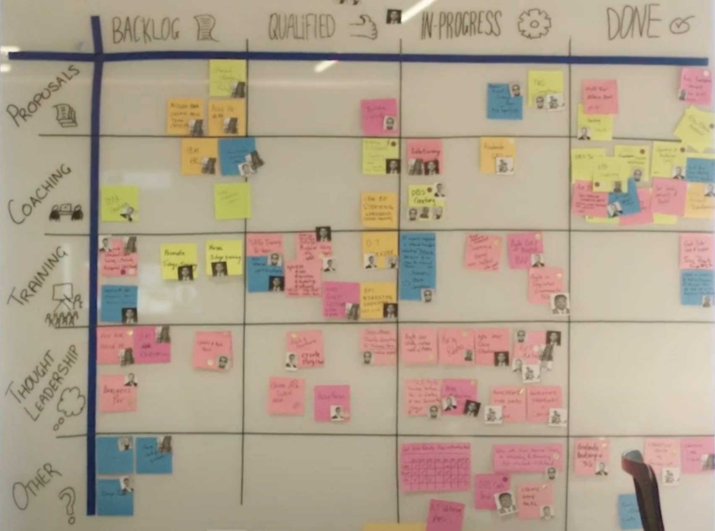
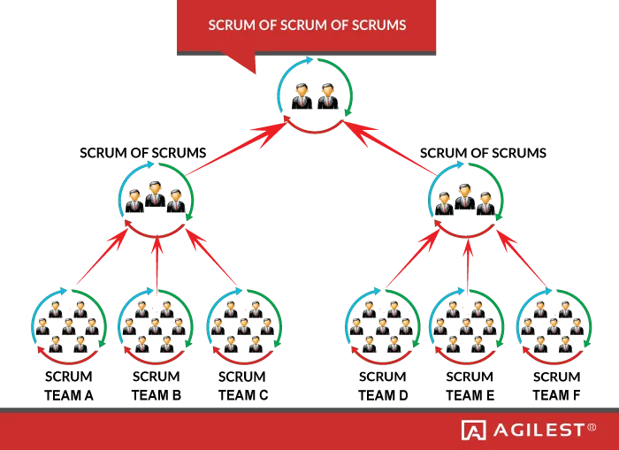
4.1 LEAN Management: Recommendations
Scalable solution to communicate several IBM subordinates (cultural clashes & paradigm shifts)
LEAN implementation is the adoption of the Simpler® tool across IBM
Implement Agile in and Disruptive Technologies (R&D)
Data about impact of Agile adoption should be transparent
IBM should execute an adjustment version of Scrum of Scrums following the LEAN principles
In 2021, IBM Consulting were up 8% by revenue in constant currency.
ScrumBan in IBM Studios Singapore
Source: IBM’s Agile Transformation -Scrum Alliance
Source: Agilest.org

Slide 9
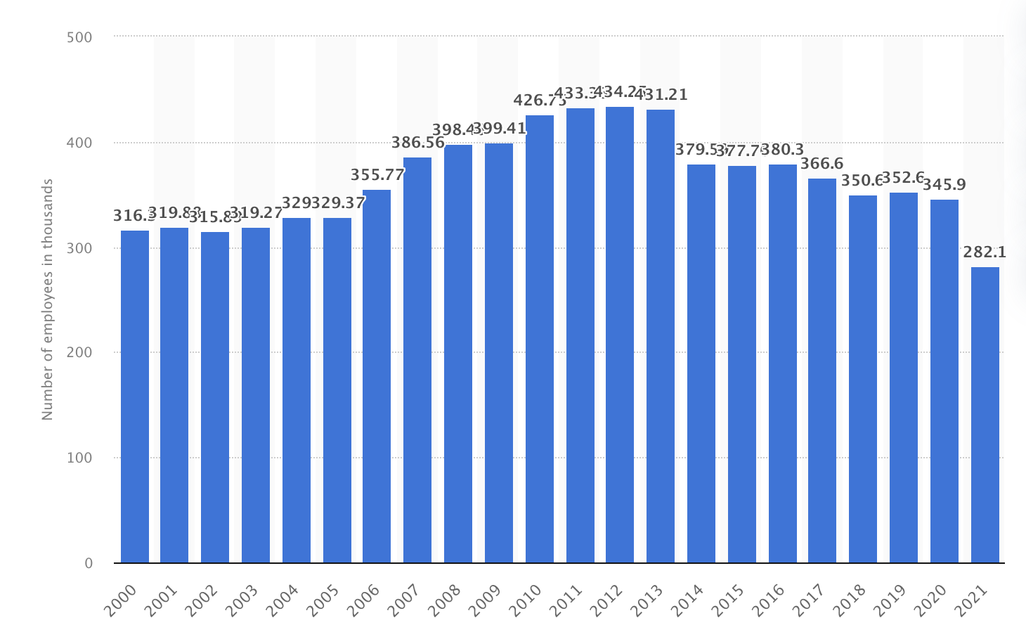
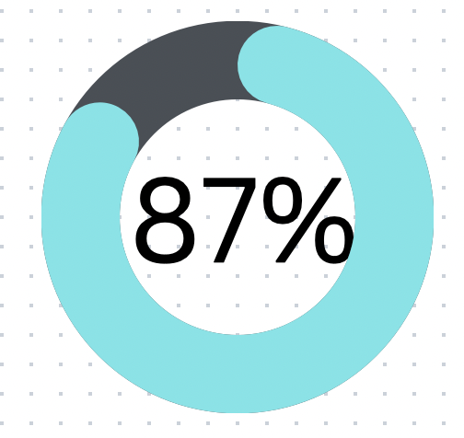
5. HR Management: Analysis
Key issues within IBM HR department:-
A major organisational disconnect between top level executives and employees
Lack of skilled personnel
Underpaid and unappreciated employees
Job cuts and layoffs
Lack of adequate leadership
Inefficient employee performance management
Is Big Blue still one of the largest IT employer in the world?
Restructure the performance appraisal system?
A survey of more than 50,000 IBM employees was conducted and reports suggest that 87% of employees feel the work measurement strategy is inefficient
Job cuts and layoffs has resulted in significant workforce reduction at IBM
Source-https://www.workhuman.com/blog/driving-a-cultural-transformation-ibm-s-performance-development-journey/
https://www.statista.com/statistics/265007/number-of-employees-at-ibm-since-2000/

Slide 10
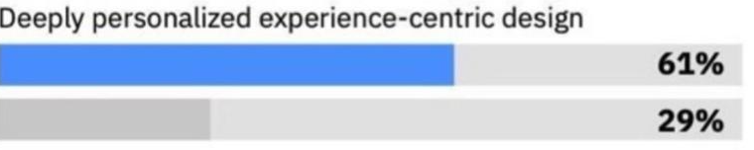
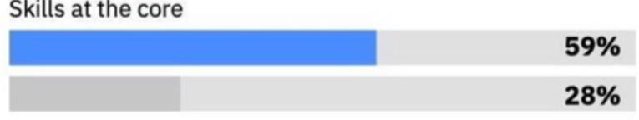
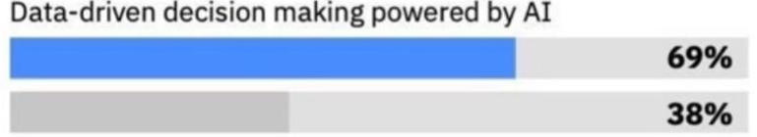
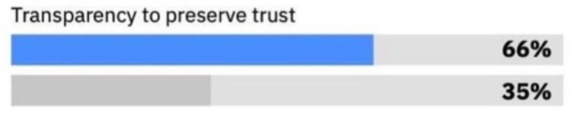

5.1 HR Management: Impact
Overall impact of HR issues on IBM
Lack of skilled labour in the manufacturing and blockchain department has led to significant customer service complaints
Since 2011 IBM workforce has a reduction of 35% due to lack of internal transparency
Severe Job cuts, layoffs along with poor job design strategies has led to 26% year-on-year decline in revenue.
Significant losses and lesser workforce has resulted in discontinuation of major IBM products like TradeLens and Food Trust
Reduction in workforce has also resulted in a global shortage of IBM mainframes and semiconductors
Where does IBM stand as an organization in the areas which affect human resource the most?
Source-https://www.techrepublic.com/article/ibm-report-employees-say-they-have-a-lack-of-skills-support-and-transparency/
https://www.digitaljournal.com/business/does-not-compete-the-decline-of-ibm/article

Slide 11
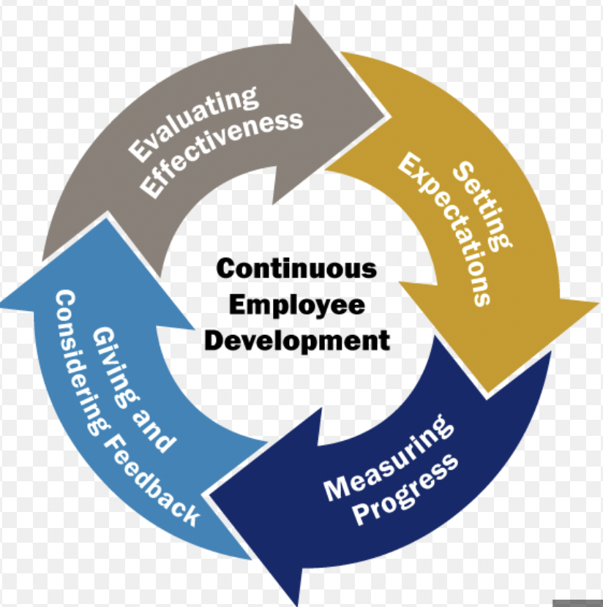
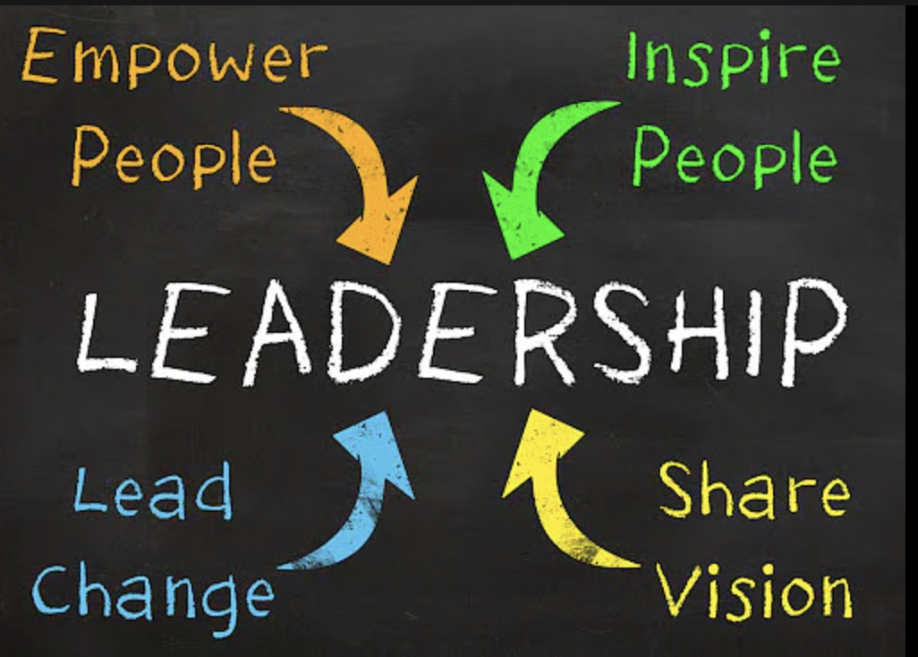
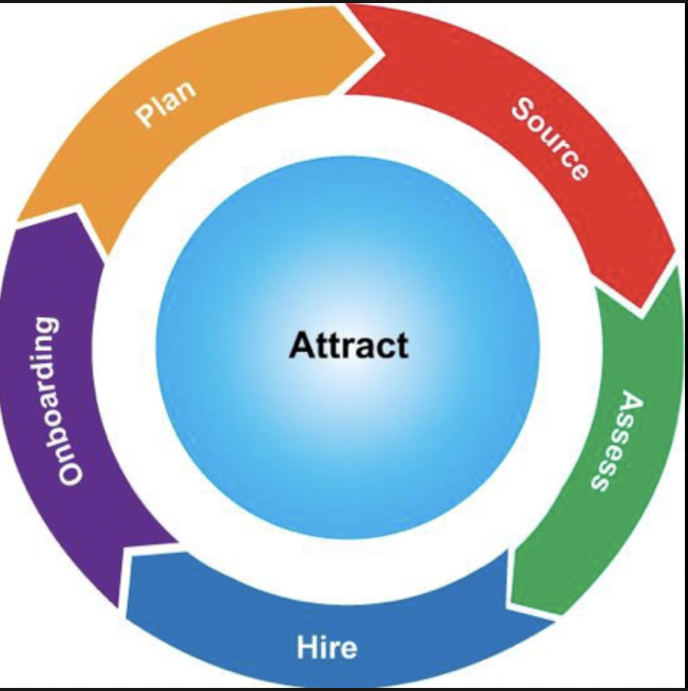

5.2 HR Management: Solutions & Recommendations
Major Impact
10 action areas of improvement:
Continuous and transparent employee performance
Invest more on leadership
Develop and use capabilities in agile and design thinking
Pay for performance and skills
Continuously build skills in workflow
Design intentional experience for employees
Modernize HR portfolio
Apply data driven insights
Reorientation and reskilling of HR business partner
Strategic sourcing of new talent
Invest more on leadership
Continuous and transparent employee performance management
Pay for performance and skills
Strategic sourcing of new talent

Slide 12
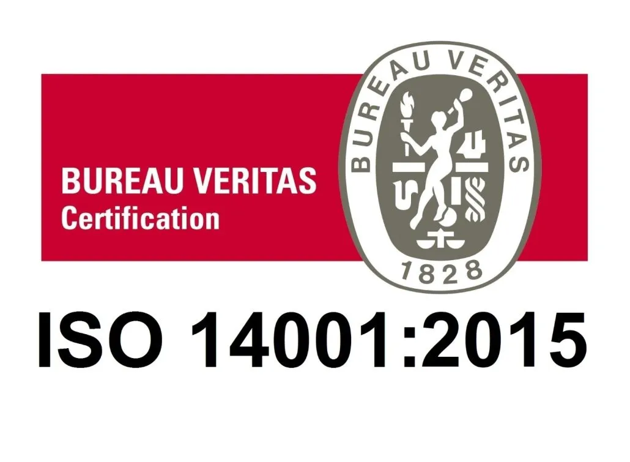
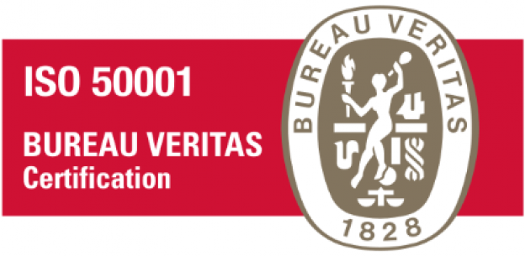
6. Supply Chain & Sustainability: Analysis
IBM has a global and a very complex supply chain where the focus is on selling hardware, middleware and softwares all over the world along with its blockchain technology.
From the six major sourcing strategies IBM has adopted the “Many Suppliers” sourcing strategy
IBM has 14,000 suppliers and 282,100 employees in about 100 countries
IBM Supply chain operates in a hybrid model which consists of build-to-plan and build-to-order
The use of data analytics and advanced technologies makes IBM one of the world’s greenest companies and their data centres are most efficient and use 50% less energy than other companies
Quality & Sustainability:
ISO 14001 Environmental Management
ISO 50001 Energy Management Systems
3 Key Issues in supply chain management due to decentralized structure across IBM’s many branches:
Roles and responsibilities not clearly defined
Direct Managers in different locations from team resulting in communication problems
Lack of communication between different layers of management resulting in issues taking a very long time to be addressed
“Lack of Agility”

Slide 13
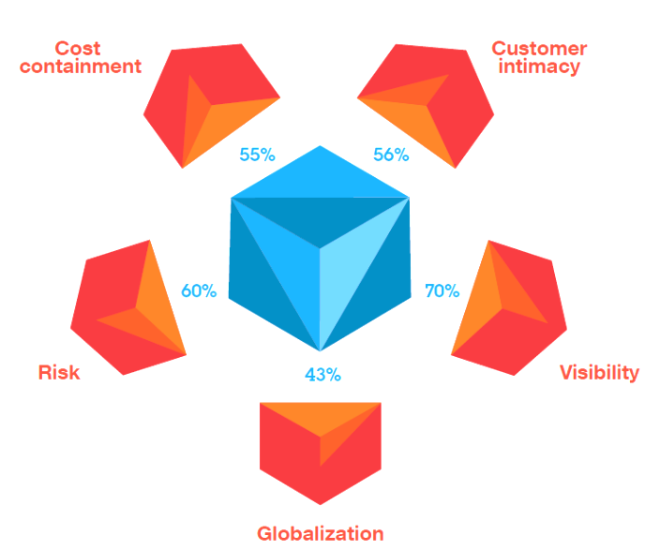
6.1 Supply chain & Sustainability: Impact
Overall impact of Supply Chain management issues on IBM
IBM doesn’t make it to the list of top 15 companies with best CSR policy and more than 73% millennials prefer working for a company with great CSR policies
IBM is also facing 5 key supply chain challenges which are Cost containment, Risk, Customer Intimacy, Visibility and Globalization
TradeLens, which was launched in 2018 to remove inconsistencies in supply chain data in shipping industry, is shutting down in 2023 Q1
Lack of technical knowledge to understand blockchain technology
Farmer Connect & Sustainability blockchain-based certification does not have the desired impact in market
Source:https://enterpriseresilienceblog.typepad.com/enterprise_resilience_man/2011/04/ibms-top-five-supply-chain-challenges.html

Slide 14
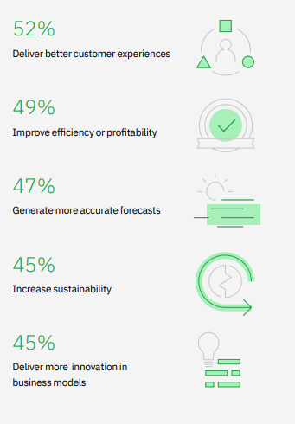
6.2 Supply chain and Sustainability: Solutions & Recommendations
Focus on CPFR i.e. Collaborative Planning, Forecasting, and Replenishment resulting in faster Response Time and better collaboration. Reduces Bullwhip Effect as well
Business relations with suppliers only in they follow sustainability laws and maintain ethical behavior towards the environment
W.r.t Blockchain and supply chain:
Improve scalability issues
Reduce transaction costs
Ensure all partners have technical knowledge to use and support blockchain technology
Address privacy concerns
Improve industry collaboration
Emphasize sustainability practices in supply chain ,leadership and employee assessments, and investment criteria and encourage collaborating with customers over sustainability practices
While using AI and advanced analytics try and ensure there is a standardized procedure employees can follow globally for quick decision making
Source:https://www.ibm.com/downloads/cas/1BYY6VEM

Slide 15
7. Conclusion
Service & Process Strategy:
Is recommended more training of existing system administrators and hiring more administrators, flexibility, partnerships with more organizations and offering customization
LEAN Management & Agile:
IBM is highly decentralized -and usually- asynchronous in agile practices across every service: IBM Consulting, IBM Software and IBM Infrastructure, Simpler® and Agile teams needs to apply scalability to coordinate as a whole using SoS
HR Management:
IBM should focus on improving work measurement strategies, invest more in leadership, hire employees more strategically, improve ergonomics and workspaces within the organization, try implementing people analytics to improve workflow and lastly pay the employees based on their performance Supply Chain & Sustainability:
Focus should be on making sustainability a core practice, focusing on open innovation, CPFR, and focusing on process improvement that ensure supply chain agility and faster response time

Slide 16
THANK YOU!

